Slide 1
Google Looker Master Class
Jay S - April 13, 2024

Slide 2

Mastering Google Looker Studio: A Comprehensive Training
Introduction to Looker Studio
Understanding Data Analytics
Exploring Data with Looker Studio
Visualizing Data in Looker Studio
Building Data Models with Looker Studio
Developing Custom Solutions with Looker Studio
Data Exploration & Transformation
Building Interactive Dashboards
Data Visualization and Dashboards
Advanced Features and Data Analysis

Slide 3

Understanding Looker Studio
What is Looker Studio?
Key Features
Use Cases
Looker Studio is a powerful data visualization tool that transforms complex data into interactive & easy-to-understand dashboards and reports. It provides a user-friendly interface for creating insightful visualizations from raw data.
Looker Studio offers a range of features, including drag-and-drop functionality, customizable dashboards, and seamless integration with various data sources, making it a versatile tool for data analysis and reporting.
Explore real-world examples of how Looker Studio is used across different industries to gain valuable insights from data, improve decision-making, and drive business growth.

Slide 4
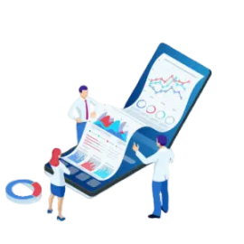
Navigating the Looker Studio Interface
Dashboard Creation
Learn how to navigate the Looker Studio interface and create visually appealing dashboards using the intuitive drag-and-drop tools. Understand the various components of the interface and how to customize them to suit specific data visualization needs.
Data Connectivity
Explore the seamless integration capabilities of Looker Studio with different data sources, including Google Analytics, and understand how to connect and import datasets for visualization.
User Roles and Permissions
Gain insights into the user roles and permissions within Looker Studio, ensuring secure access and control over data visualization and reporting.

Slide 5
Building Your First Looker Studio Dashboard
Data Exploration
Dive into the process of exploring and understanding the dataset examples provided within Looker Studio. Learn how to identify key metrics, dimensions, and attributes to build a foundation for effective data visualization.
Visualization Tools
Explore the diverse range of visualization tools available in Looker Studio, including charts, graphs, and tables, and understand how to select the most suitable visualization type for different data sets.
Best Practices
Discover best practices for designing and structuring dashboards to ensure clarity, user engagement, and effective communication of insights.

Slide 6
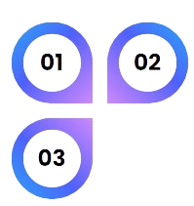
Industry Applications
Success Stories
Delve into case studies from various industries, such as e-commerce, healthcare, and finance, to understand how Looker Studio has been utilized to solve complex data visualization challenges and drive business impact.
Explore success stories and testimonials from organizations that have leveraged Looker Studio to gain actionable insights, optimize processes, and achieve strategic goals through data-driven decision-making.
Interactive Discussion
Engage in an interactive discussion about the potential applications of Looker Studio within the participants' own organizations, encouraging brainstorming and idea sharing.

Slide 7
Section 2
Data Visualization and Dashboards

Slide 8
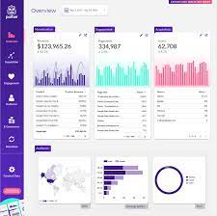
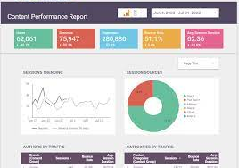
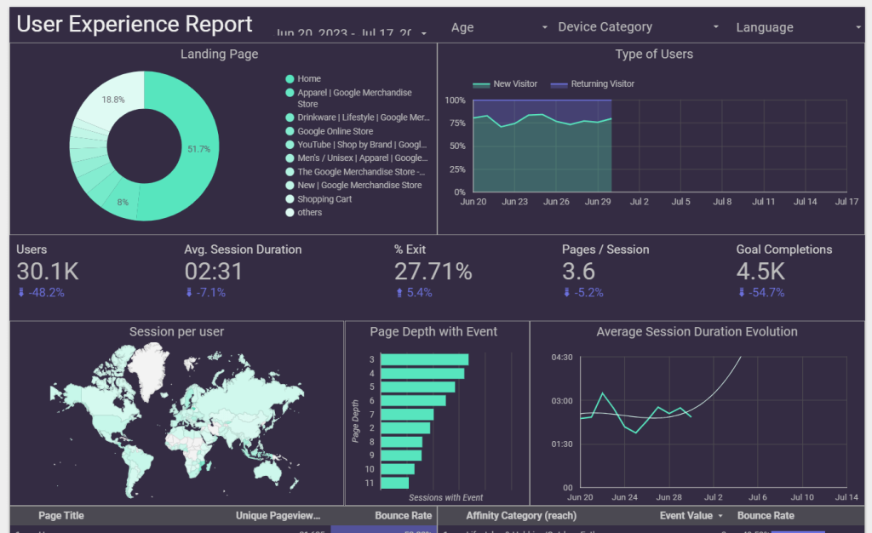
Creating Interactive Visualizations
Customization Options
Filtering and Sorting
Data Storytelling
Learn how to customize visualizations in Looker Studio to create interactive and dynamic charts, enabling users to drill down into specific data points and gain deeper insights.
Understand the techniques for applying filters and sorting options to visualizations, allowing users to interact with the data and tailor their viewing experience based on specific criteria.
Explore the art of data storytelling and how to use visualizations to convey compelling narratives that resonate with the audience and drive impactful decision-making.

Slide 9
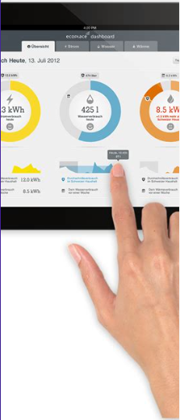
Proposed deliverables
Effective Layouts
Discover the principles of effective dashboard design, including the arrangement of visualizations, use of white space, and the importance of visual hierarchy to guide the audience's attention.
Color and Typography
Understand the role of color and typography in dashboard design, ensuring readability, accessibility, and the conveyance of meaning through visual elements.
Accessibility Considerations
Explore best practices for designing accessible dashboards that cater to diverse user needs, including considerations for color blindness and screen reader compatibility.

Slide 10
Data Exploration and Analysis
01
02
03
Drilling Down into Data
Trend Analysis
Comparative Analysis
Learn how to enable users to drill down into specific data points within visualizations, empowering them to explore detailed information and gain a comprehensive understanding of the underlying data.
Understand how to incorporate trend analysis and time-series visualizations within dashboards to identify patterns, anomalies, and insights over time, aiding in strategic decision-making.
Explore techniques for conducting comparative analysis through visualizations, such as side-by-side comparisons and trend differentials, to derive actionable insights from data.

Slide 11
Section 3
Advanced Features and Data Analysis

Slide 12

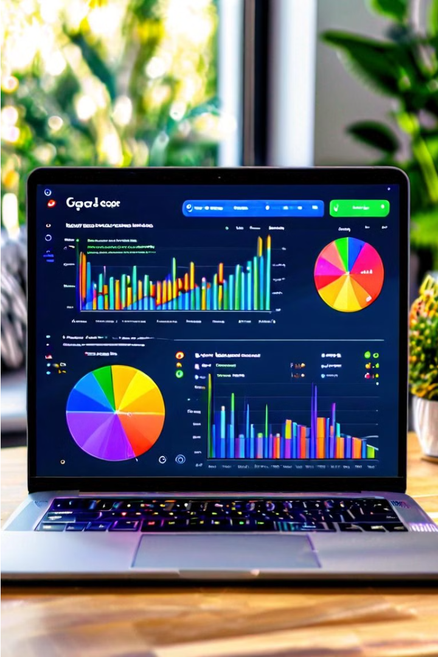

Introduction to Google Looker Studio
Google Looker Studio is a powerful data visualization and reporting tool that allows users to transform raw data into compelling, interactive dashboards and reports. In this comprehensive training, we will explore the full capabilities of Looker Studio, covering everything from connecting to data sources to building advanced visualizations and dashboards. Whether you're a business analyst, marketing professional, or data enthusiast, this training will equip you with the skills to unlock the true potential of your data and make informed, data-driven decisions.
by Jay S

Slide 13

Data sources and data preparation
1
Connecting to Data Sources
The first step in using Looker Studio is to connect to your data sources. Looker Studio supports a wide range of data sources, including spreadsheets, databases, cloud storage, and more. We'll walk through the process of securely connecting to your data, whether it's stored locally or in the cloud.
2
Data Preparation
Once your data sources are connected, you'll need to prepare the data for analysis. This may involve cleaning, transforming, and enriching the data to ensure it's accurate and ready for visualization. Looker Studio provides powerful data preparation tools to help you get your data in tip-top shape.
3
Data Blending
In many cases, you'll need to combine data from multiple sources to get a complete picture. Looker Studio's data blending capabilities allow you to seamlessly integrate data from different sources, enabling you to create comprehensive reports and dashboards.

Slide 14
Connecting data to Looker Studio
Exploring Data Models
Defining Dimensions and Measures
Applying Filters and Calculations
Looker Studio's data modeling tools allow you to create a unified, logical view of your data, making it easier to build visualizations and reports. We'll explore how to create and customize data models to fit your specific business needs.
Dimensions and measures are the building blocks of Looker Studio visualizations. Dimensions are the descriptive attributes of your data, while measures are the numeric values you want to analyze. We'll dive into the process of defining and managing these essential elements.
Looker Studio provides advanced filtering and calculation capabilities to help you refine and manipulate your data. We'll explore how to use these tools to create custom metrics, segment your data, and uncover deeper insights.

Slide 15
Building dashboards and visualizations
1
Designing Intuitive Dashboards
2
Choosing the Right Visualizations
Looker Studio's dashboard builder allows you to create visually appealing and user-friendly dashboards that display your data in a clear and organized manner. We'll cover best practices for dashboard design, including layout, color schemes, and information hierarchy.
Looker Studio offers a wide range of data visualization options, from bar charts and line graphs to scatter plots and heatmaps. We'll explore the strengths and use cases of each visualization type, helping you select the most appropriate visualizations for your data and storytelling needs.
3
Customizing Visualizations
4
Drilling Down and Exploring Data
Beyond the standard visualization options, Looker Studio allows you to customize and fine-tune your visualizations to suit your specific requirements. We'll cover advanced techniques for adjusting colors, labels, axes, and other visual elements to create truly unique and impactful data displays.
Looker Studio's interactive features enable users to dive deeper into the data, exploring underlying details and trends. We'll demonstrate how to implement drill-down functionality, allowing your audience to uncover insights at different levels of granularity.

Slide 16
Advanced dashboard features
User Filtering and Parameter Controls
Calculated Fields and Metrics
Sometimes, the data you need may not be directly available in your source systems. Looker Studio's calculated fields feature enables you to create custom metrics and derived data elements that can be used in your visualizations and analyses. We'll dive into the process of building and managing these powerful custom data elements.
Looker Studio allows you to create dynamic dashboards that empower users to explore and filter the data based on their specific needs. We'll cover how to implement user-driven filters, parameter controls, and other interactive features that enhance the user experience and enable deeper data exploration.
Conditional Formatting and Alerting
Data Exploration and Discovery
Looker Studio's advanced data exploration tools empower users to uncover hidden insights and spot trends that might otherwise be missed. We'll demonstrate how to leverage features like data exploration, anomaly detection, and predictive analytics to unlock the full potential of your data.
To help users quickly identify important insights, Looker Studio provides conditional formatting and alerting capabilities. We'll explore how to set up dynamic formatting rules and custom alerts that draw attention to key performance indicators and anomalies in your data.

Slide 17




Sharing and collaborating in Looker Studio
Sharing Dashboards
Looker Studio makes it easy to share your dashboards with colleagues, clients, or stakeholders. We'll cover the various sharing options, including publishing reports, embedding dashboards, and managing access controls to ensure your data remains secure.
Collaborative Editing
Looker Studio supports real-time collaborative editing, allowing multiple users to work on the same dashboard simultaneously. We'll explore the tools and best practices for effective team-based data analysis and reporting.
Scheduling and Automation
To ensure your stakeholders always have access to the latest data, Looker Studio provides scheduling and automation features. We'll demonstrate how to set up automated report generation and delivery, as well as how to create custom alerts and notifications based on your data.

Slide 18




Customizing the user experience
Theming and Branding
Customizing Layouts and Templates
User Permissions and Access Control
Mobile Optimization
Looker Studio allows you to apply custom branding and styling to your dashboards, ensuring a cohesive and professional user experience. We'll cover how to configure the color scheme, typography, and logos to align with your organization's brand guidelines.
With Looker Studio's mobile-responsive design, your dashboards can be accessed and viewed on a wide range of devices, from desktops to smartphones. We'll cover best practices for optimizing your dashboards for mobile use, ensuring a seamless and engaging experience for your on-the-go stakeholders.
Beyond the standard dashboard layouts, Looker Studio enables you to create custom templates and layouts that cater to your specific reporting requirements. We'll explore the tools and techniques for building tailored dashboard designs that maximize the impact of your data visualizations.
Ensuring the right users have access to the appropriate data is crucial for maintaining data security and privacy. We'll discuss Looker Studio's robust user management and access control features, allowing you to configure granular permissions and control who can view, edit, and share your dashboards.

Slide 19

Conclusion and next steps
In this comprehensive training, we have explored the full capabilities of Google Looker Studio, equipping you with the knowledge and skills to transform raw data into powerful, interactive dashboards and reports. From connecting to data sources to building advanced visualizations and customizing the user experience, you now have the tools to unlock the true potential of your data and make informed, data-driven decisions.
As you continue your Looker Studio journey, remember to stay curious, experiment with new features, and keep exploring ways to enhance your data analysis and presentation. The more you immerse yourself in the platform, the more you'll discover its depth and versatility. Remember, the best dashboards are not just visually appealing, but also tell a compelling story that drives action and delivers meaningful impact. Embrace the power of Looker Studio, and let your data shine!

Slide 21
Utilizing Looker Studio for Predictive Analytics
Data exploration: Utilizing Looker to discover trends, patterns, and possible insights
Visualization: Creating interactive visual representations of predictive models and data
Collaborative insights: Sharing and discussing predictive analytics with stakeholders

Slide 22
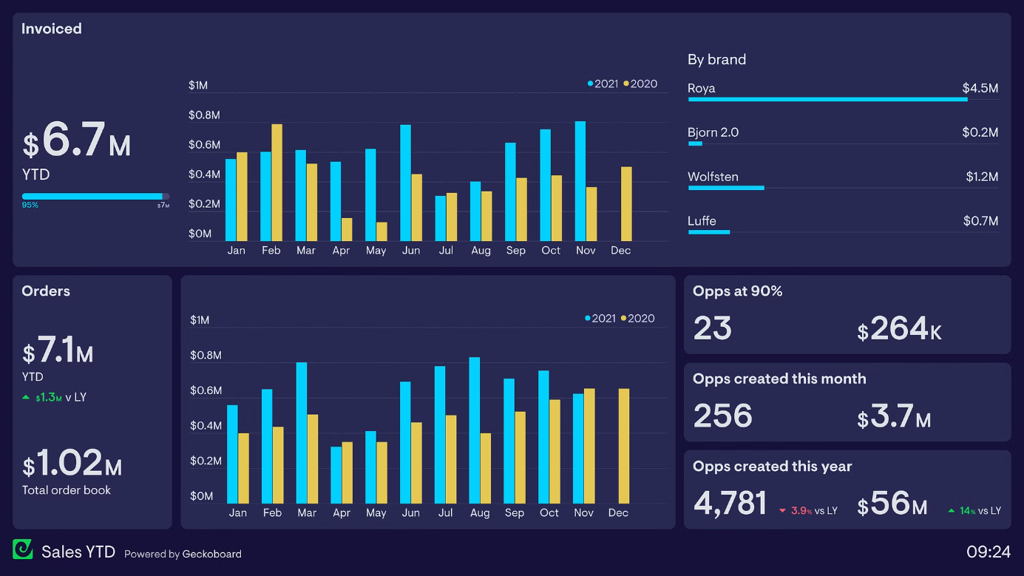

Slide 23
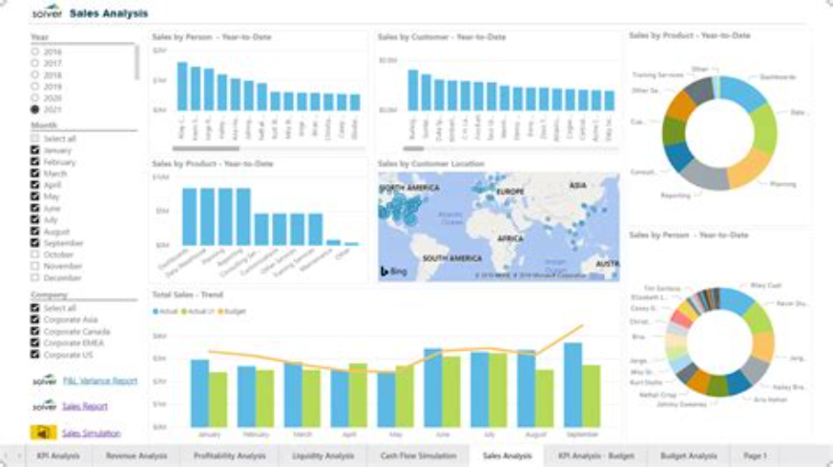

Slide 24
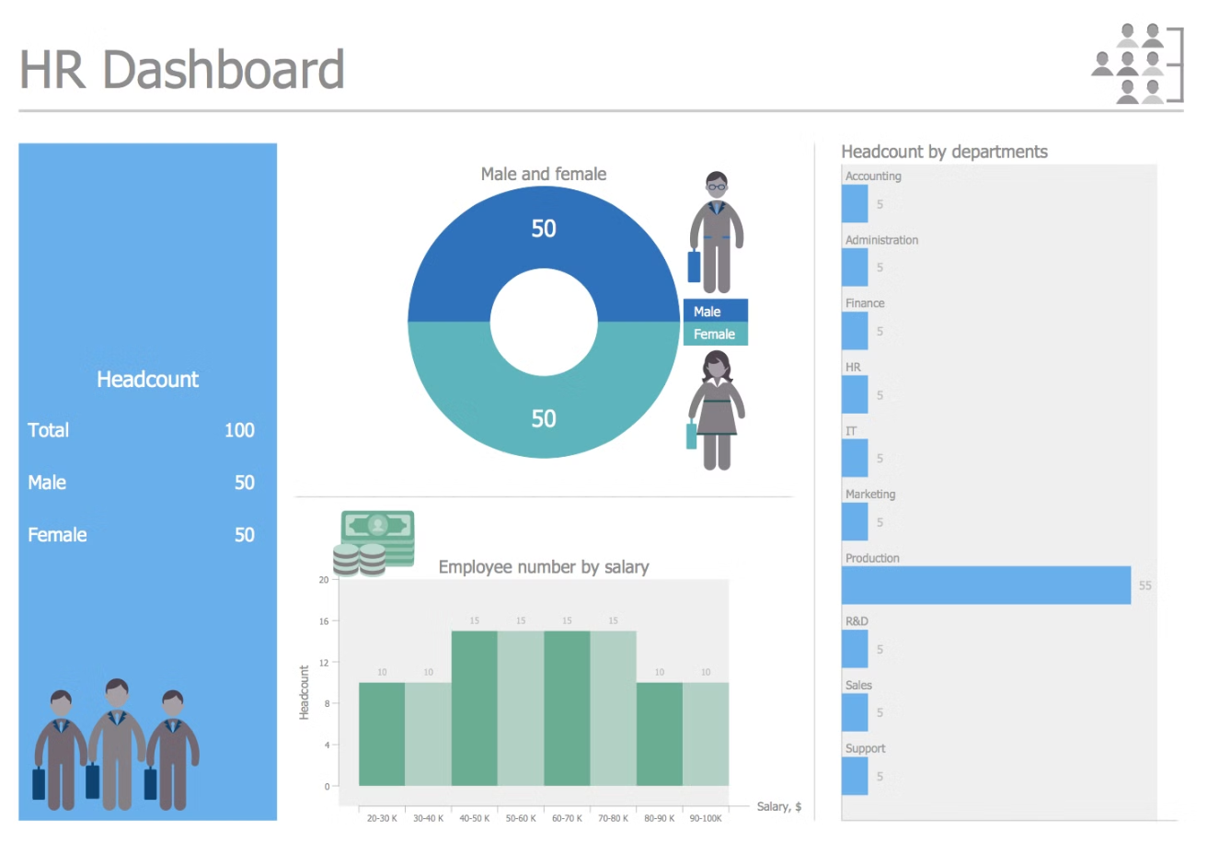

Slide 25

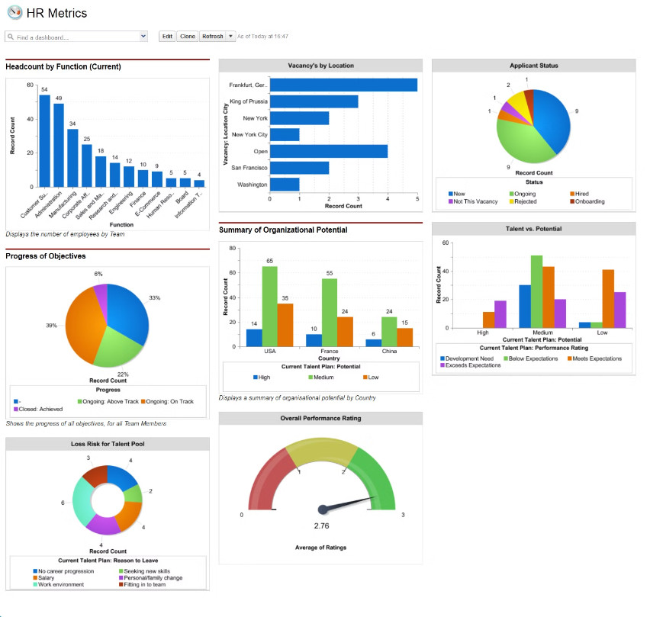

Slide 26




Data Storytelling Techniques
Data Visualization
Data Communication
Data Interpretation
Data Analysis
Analyzing data to uncover trends, patterns, and actionable insights for storytelling.
Illustrating data with engaging and clear visual representations for easy understanding.
Conveying complex data insights in a simple, compelling manner to diverse audiences.
Utilizing analytical thinking to interpret data and craft a compelling narrative.

Slide 27

Data Security and Compliance
Data security and compliance are essential for protecting sensitive information and meeting regulatory standards. It involves implementing robust policies and procedures, ensuring encryption and access controls, and regularly auditing systems.

Slide 28

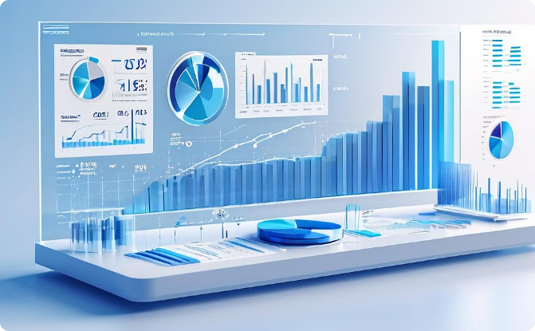
Data-driven decision making
Collaborative Analysis
Visual Data Representation
Teams leverage diverse skill sets for thorough data examination, fostering innovative insights and informed decision-making.
Utilizing modern tools to craft dynamic visual representations, aiding in clear and compelling data storytelling.

Slide 29
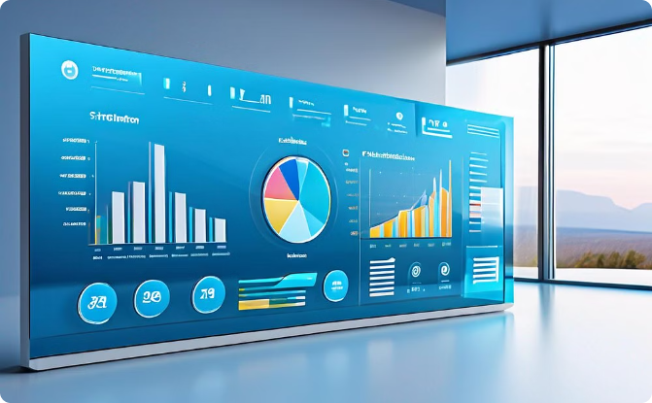

Interactive Dashboard Design Techniques
User-Friendly Interface
Engaging Visualizations
Create an engaging user experience with vibrant colors and an intuitive layout that encourages interaction.
Utilize animated charts and modern typography for visually compelling data representation.

Slide 30

Data Quality Assessment
Accurate Data Assessment
Thorough analysis and professional workspace for ensuring data accuracy and quality.

